Slide 1

POWER TO THE PEOPLE:
Analysing and predicting household power consumption
Motivation
The energy sector
is responsible for
21%
of greenhouse gas emissions
The average energy bill could reach
£4,649
by January 2023
Trihao Van

Slide 2
Motivation
POWER TO THE PEOPLE:
Analysing and predicting household power consumption
The energy sector
is responsible for
21%
of greenhouse gas emissions
The average energy bill could reach
£4,649
by January 2023
Trihao Van

Slide 3
Motivation
The energy sector
is responsible for
21%
of greenhouse gas emissions
The average energy bill could reach
£4,649
by January 2023
How might we…
help consumers reduce power consumption and make power supply more efficient?

Slide 4
Motivation
The energy sector
is responsible for
21%
How might we…
help consumers reduce power consumption and make power supply more efficient?
of greenhouse gas emissions
The average energy bill could reach
£4,649
by January 2023

Slide 5


TIME OF USE TARIFF
Consumers notified of energy price changes
How might we…
help consumers reduce power consumption and make power supply more efficient?
FIXED TARIFF
Energy price remains constant

Slide 6
TIME OF USE TARIFF
FIXED TARIFF
Consumers notified of energy price changes
Energy price remains constant

Slide 7
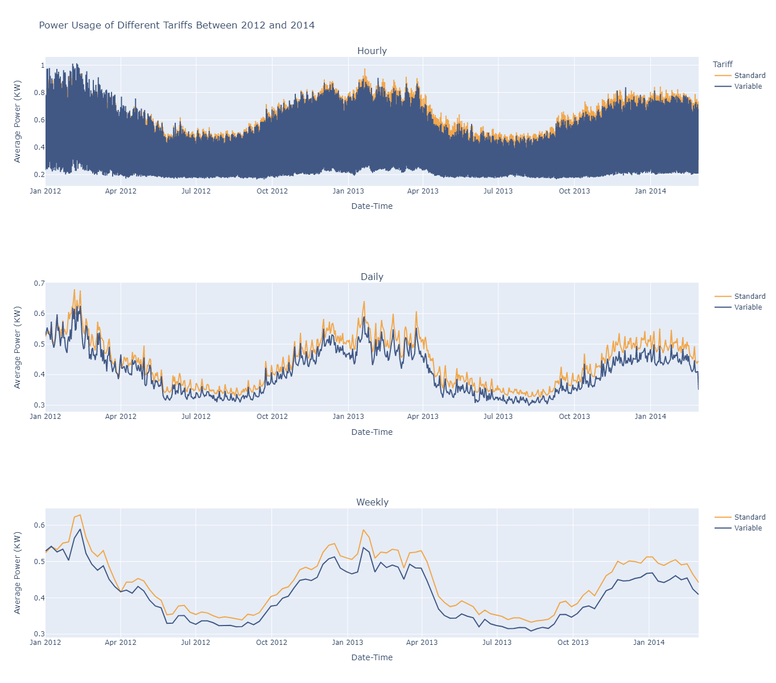


TIME OF USE TARIFF
FIXED TARIFF
Consumers notified of energy price changes
Energy price remains constant
Power consumption in
winter can be up to
1.8x
higher than in summer

Slide 8
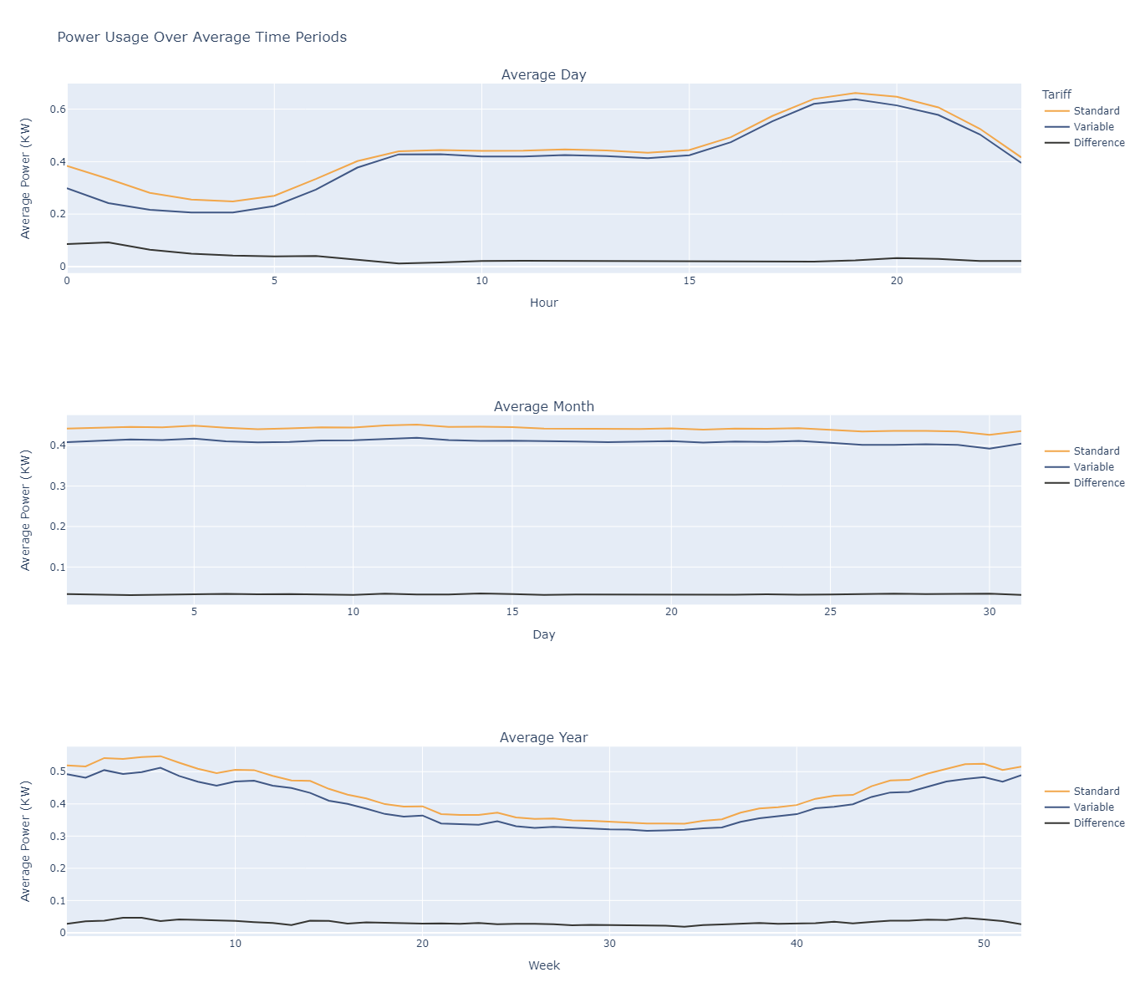
TIME OF USE TARIFF
FIXED TARIFF
Consumers notified of energy price changes
Power consumption in
winter can be up to
1.8x
higher than in summer
Energy price remains constant
Households on a variable
tariff consume
~10%
less power than those
On a standard tariff

Slide 9
Power consumption in
winter can be up to
1.8x
higher than in summer
Households on a variable
tariff consume
~10%
less power than those
On a standard tariff

Slide 10

Tune
Validate
Evaluate
Forecasting
Can machine learning predict consumption?
Power consumption in
winter can be up to
1.8x
higher than in summer
Households on a variable
tariff consume
~10%
less power than those
On a standard tariff
Linear Regression
Next period prediction
All granularities
Real-time forecast to influence consumption
2.5-6.5% error
SARIMA
Mid-long range forecast
Weekly granularity
Can provide a general comparison against current consumption
5.5-6.5% error
Holt-Winters
(Exponential Smoothing)
Mid-long range forecast
Weekly granularity
Can provide a general comparison against current consumption
3.5-6.5% error
FB Prophet
Mid-long range forecast
Daily granularity
Can be used in industry to predict daily demand
5.5-6.5% error

Slide 11
Power consumption in
winter can be up to
1.8x
higher than in summer
Tune
Validate
Evaluate
Forecasting
Can machine learning predict consumption?
Households on a variable
tariff consume
~10%
less power than those
On a standard tariff
Linear Regression
Next period prediction
All granularities
Real-time forecast to influence consumption
2.5-6.5% error
SARIMA
Mid-long range forecast
Weekly granularity
Can provide a general comparison against current consumption
5.5-6.5% error
Holt-Winters
(Exponential Smoothing)
Mid-long range forecast
Weekly granularity
Can provide a general comparison against current consumption
3.5-6.5% error
FB Prophet
Mid-long range forecast
Daily granularity
Can be used in industry to predict daily demand
5.5-6.5% error

Slide 12
Linear Regression
Next period prediction
All granularities
Real-time forecast to influence consumption
2.5-6.5% error
Tune
Validate
Evaluate
Forecasting
Can machine learning predict consumption?
SARIMA
Mid-long range forecast
Weekly granularity
Can provide a general comparison against current consumption
5.5-6.5% error
Holt-Winters
(Exponential Smoothing)
Mid-long range forecast
Weekly granularity
Can provide a general comparison against current consumption
3.5-6.5% error
FB Prophet
Mid-long range forecast
Daily granularity
Can be used in industry to predict daily demand
5.5-6.5% error

Slide 13
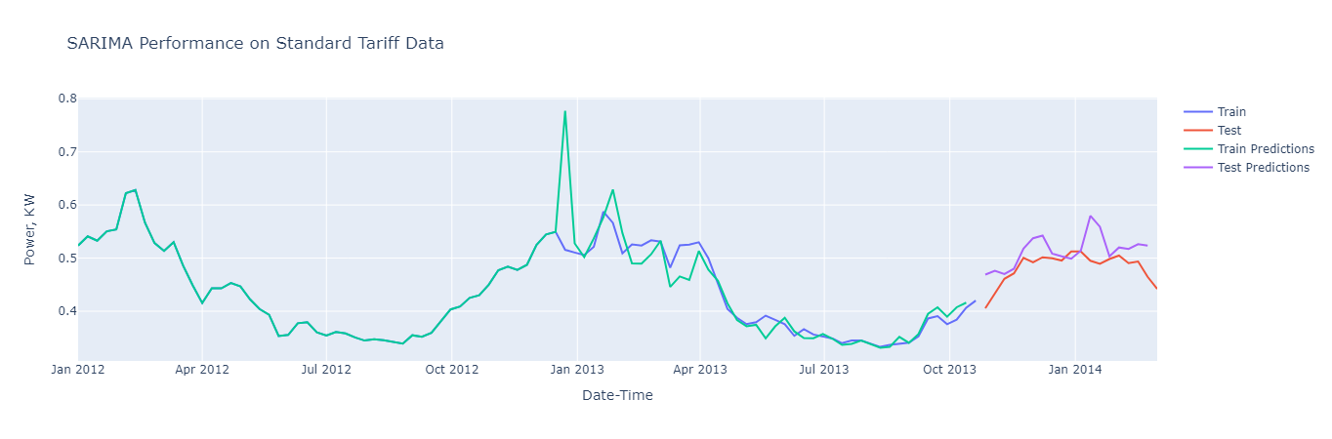
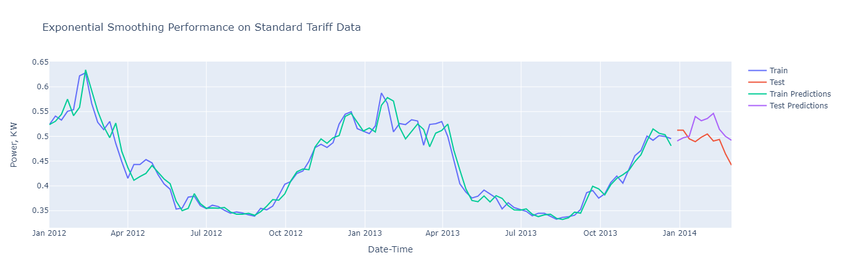
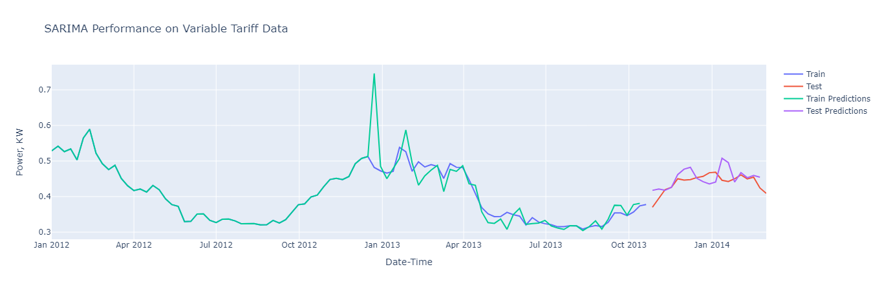
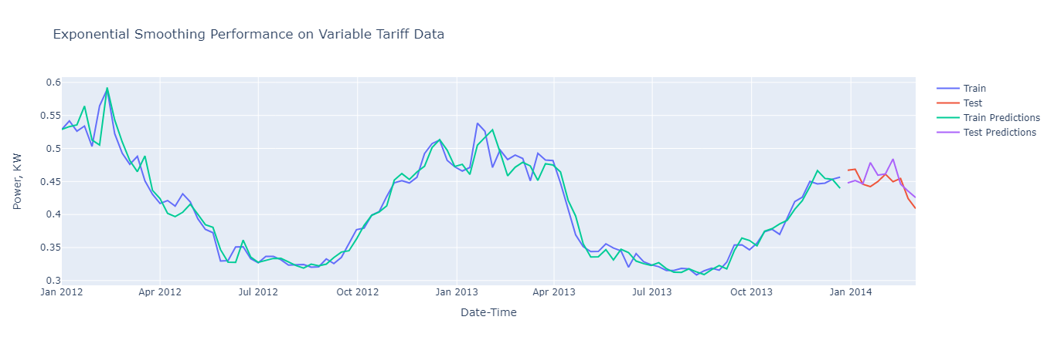
SARIMA
Mid-long range forecast
Weekly granularity
Can provide a general comparison against current consumption
5.5-6.5% error
Holt-Winters
(Exponential Smoothing)
Mid-long range forecast
Weekly granularity
Can provide a general comparison against current consumption
3.5-6.5% error
Linear Regression
Next period prediction
All granularities
Real-time forecast to influence consumption
2.5-6.5% error
Tune
Validate
Evaluate
FB Prophet
Mid-long range forecast
Daily granularity
Can be used in industry to predict daily demand
5.5-6.5% error

Slide 14
SARIMA
Mid-long range forecast
Weekly granularity
Can provide a general comparison against current consumption
5.5-6.5% error
Holt-Winters
(Exponential Smoothing)
Mid-long range forecast
Weekly granularity
Can provide a general comparison against current consumption
3.5-6.5% error
FB Prophet
Mid-long range forecast
Daily granularity
Can be used in industry to predict daily demand
5.5-6.5% error

Slide 15
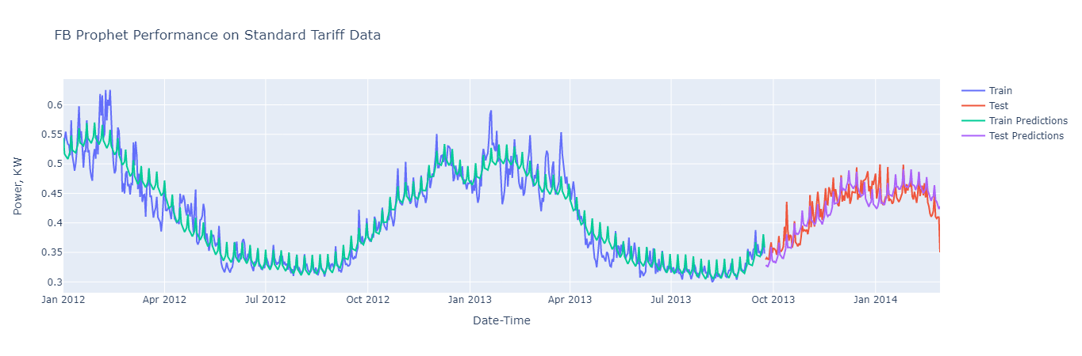
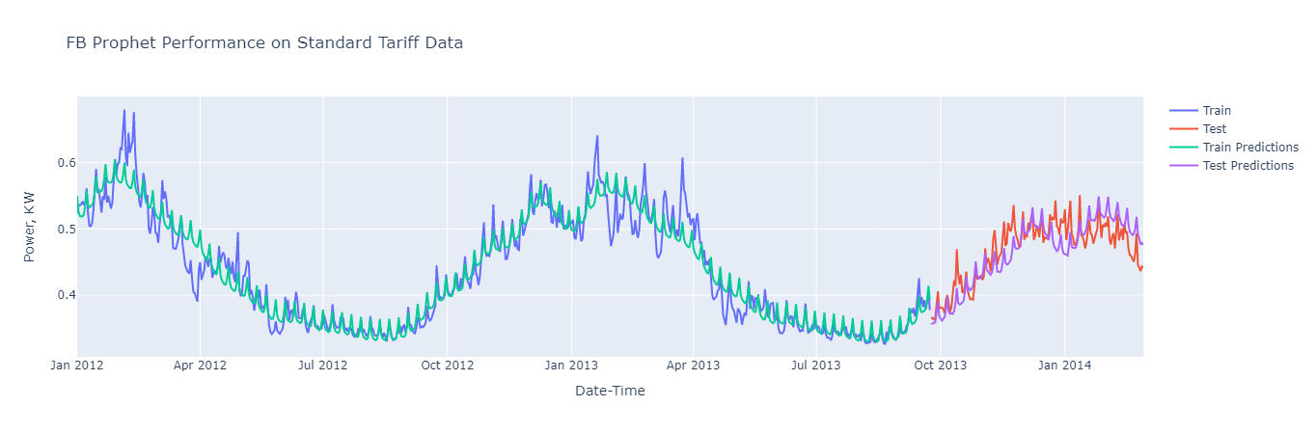
SARIMA
Holt-Winters
(Exponential Smoothing)
FB Prophet
Mid-long range forecast
Daily granularity
Can be used in industry to predict daily demand
5.5-6.5% error

Slide 16
SARIMA
Holt-Winters
(Exponential Smoothing)
FB Prophet
Mid-long range forecast
Daily granularity
Can be used in industry to predict daily demand
5.5-6.5% error

Slide 17
Conclusions
Variable tariffs are effective
Machine learning useful
(but imperfect)
FB Prophet
Mid-long range forecast
Daily granularity
Can be used in industry to predict daily demand
5.5-6.5% error

Slide 18


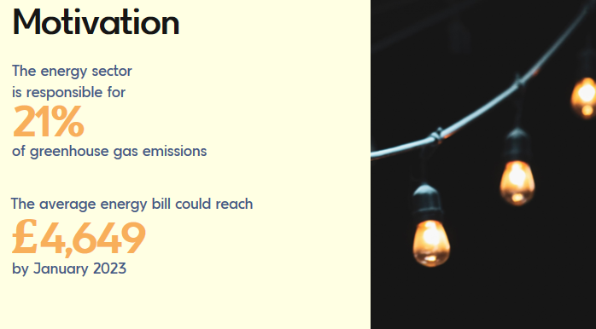
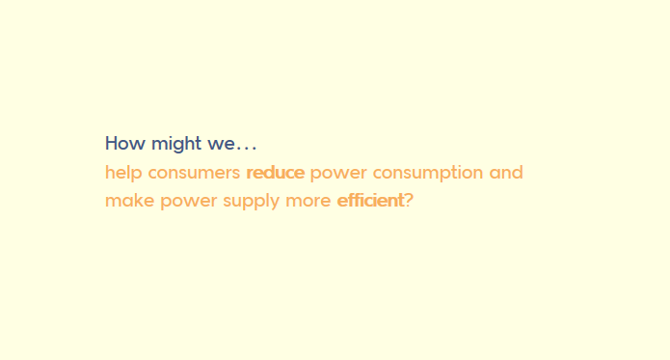
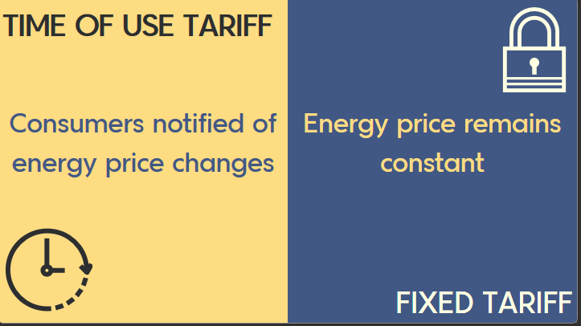
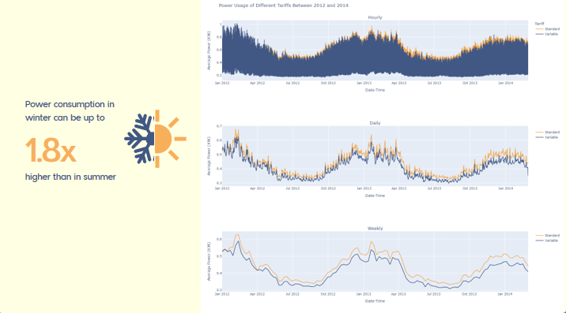
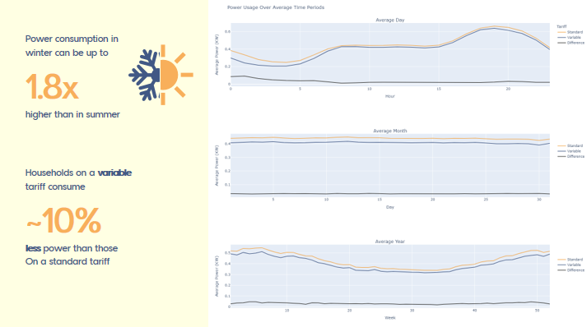
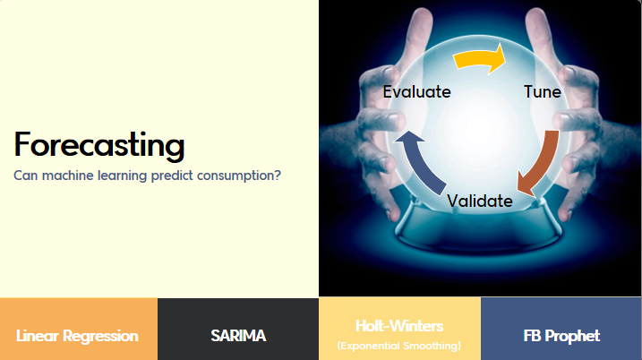
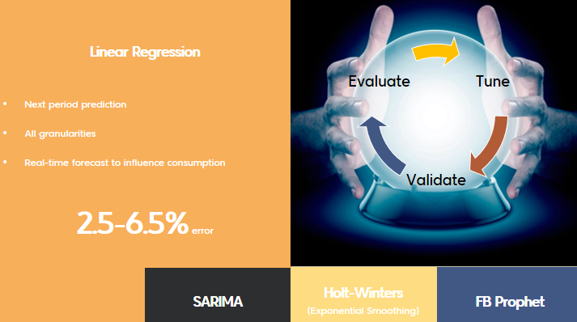
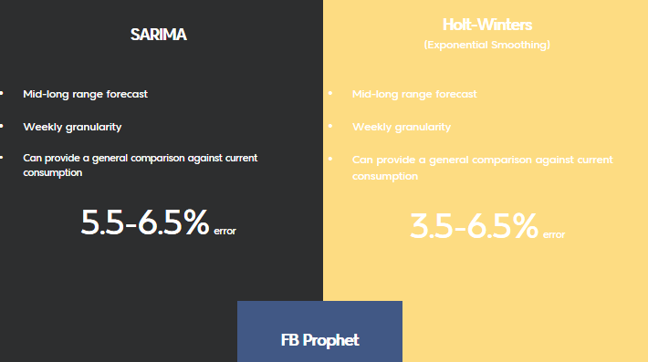
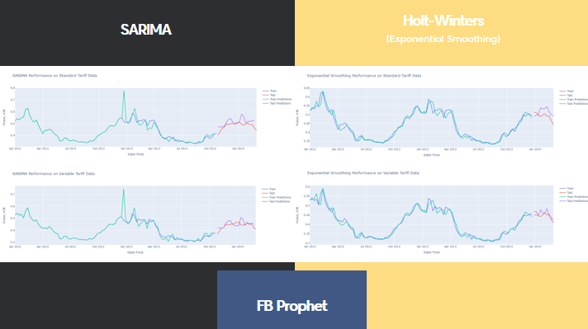
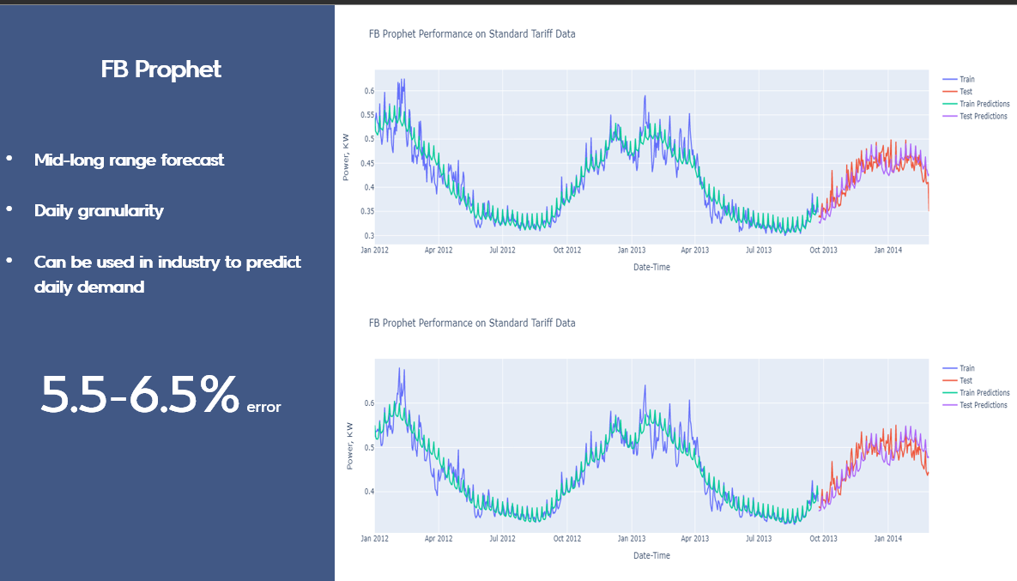
Conclusions
Variable tariffs are effective
Machine learning useful
(but imperfect)
Conclusions
Variable tariffs are effective
Machine learning useful
(but imperfect)
Conclusions
Variable tariffs are effective
Machine learning is useful
(but imperfect)
FB Prophet
Mid-long range forecast
Daily granularity
Can be used in industry to predict daily demand
5.5-6.5% error

Slide 19



Questions?
Thank you!
Future Work
Consider exogenous weather data
Use FB Prophet holidays
Find more data
Conclusions
Variable tariffs are effective
Machine learning is useful
(but imperfect)

Slide 20
Questions?
Thank you!
Conclusions
Variable tariffs are effective
Machine learning useful
(but imperfect)
Future Work
Consider exogenous weather data
Use FB Prophet holidays
Find more data

Slide 21
Questions?
Thank you!
Conclusions
Variable tariffs are effective
Machine learning useful
(but imperfect)
Future Work
Consider exogenous weather data
Use FB Prophet holidays
Find more data

Slide 22
Questions?
Thank you!
Conclusions
Variable tariffs are effective
Machine learning useful
(but imperfect)
Future Work
Consider exogenous weather data
Use FB Prophet holidays
Find more data

Slide 23
Questions?
Thank you!

Slide 24
Questions?
Thank you!

